Slide 1
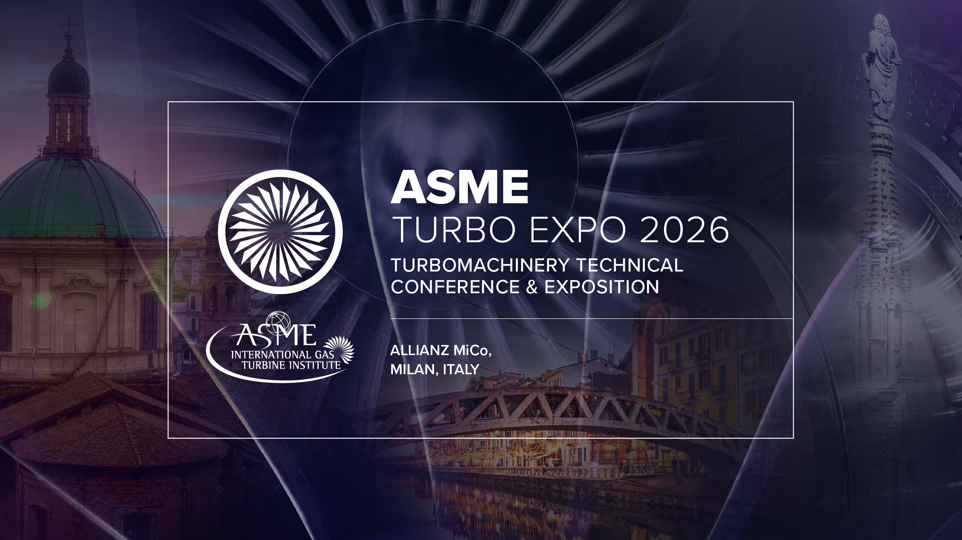
Design of an integrated solution for a portable hybrid renewable energy system
(GT2026 – 178357)
Aitor Fernández-Jiménez*, Rodolfo Espina-Valdés, Ahmed Gharib-Yosry, Eduardo Álvarez-Álvarez, Eduardo Blanco-Marigorta, Helena Ramos & Anghous McNabola

Slide 2



Índex
Energy transition: challenge of flexibility.
Small-scale renewables, large-scale impact.
HY4RES in one picture.
Renewable “four legs”.
Internet of Energy: the brain of HY4RES.
Main challenges
Gap achieved

Slide 3
Energy transition: challenge of flexibility
Energy transition is accelerating due to growing electricity demand → decarbonization targets.
Integrating renewable energy is NOT only of installed capacity.
Next challenges:
  Flexible → Adaptation to variable resources.
  Distributed → located close to point of use.
  Resilient → Under real uncertain conditions.
  Smart → monitored (IoE)

Slide 4
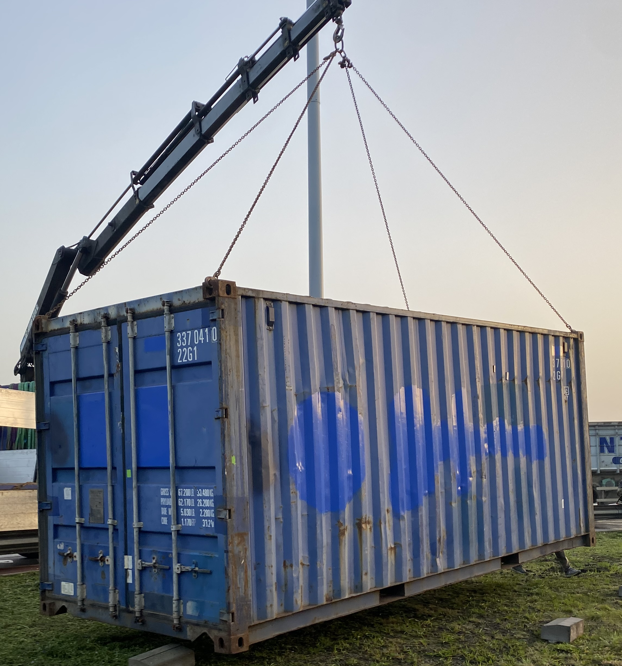
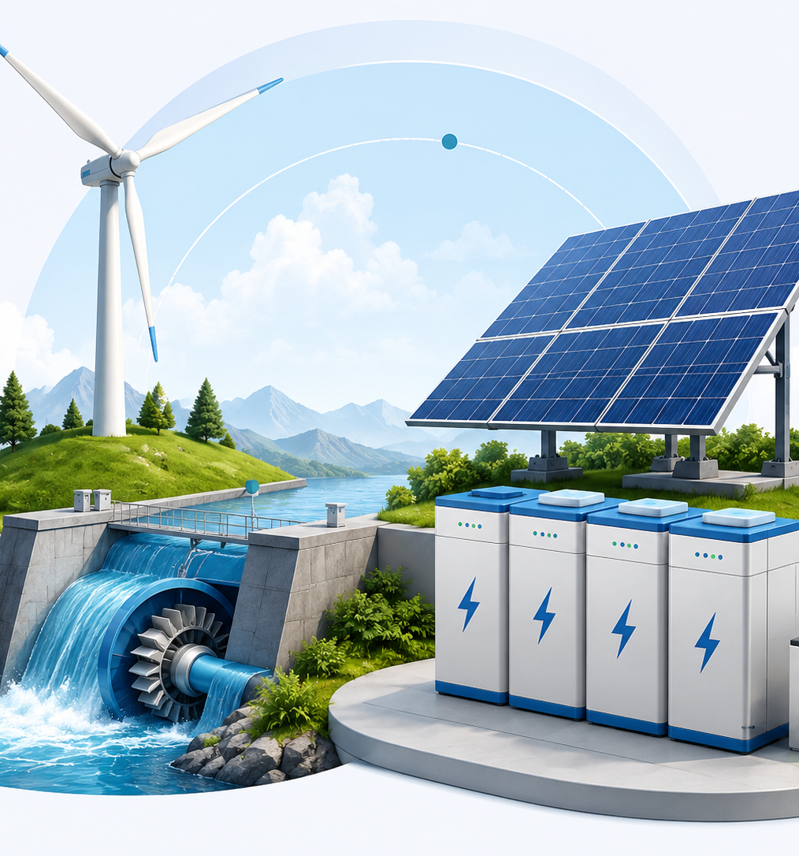
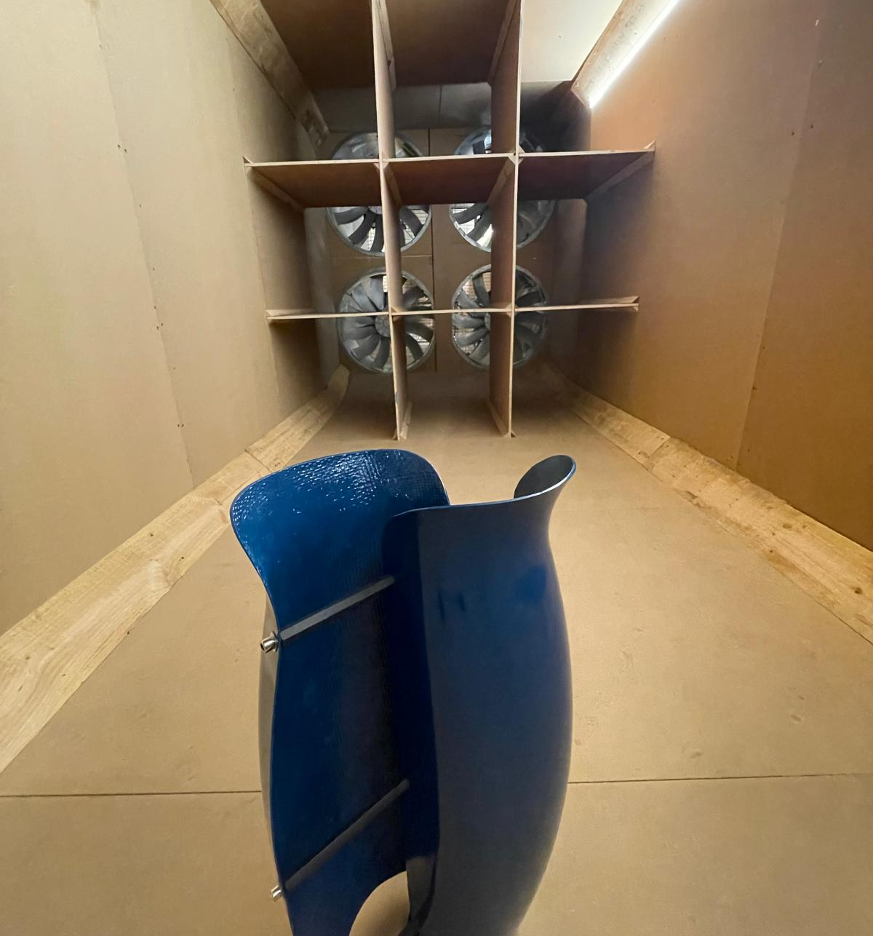
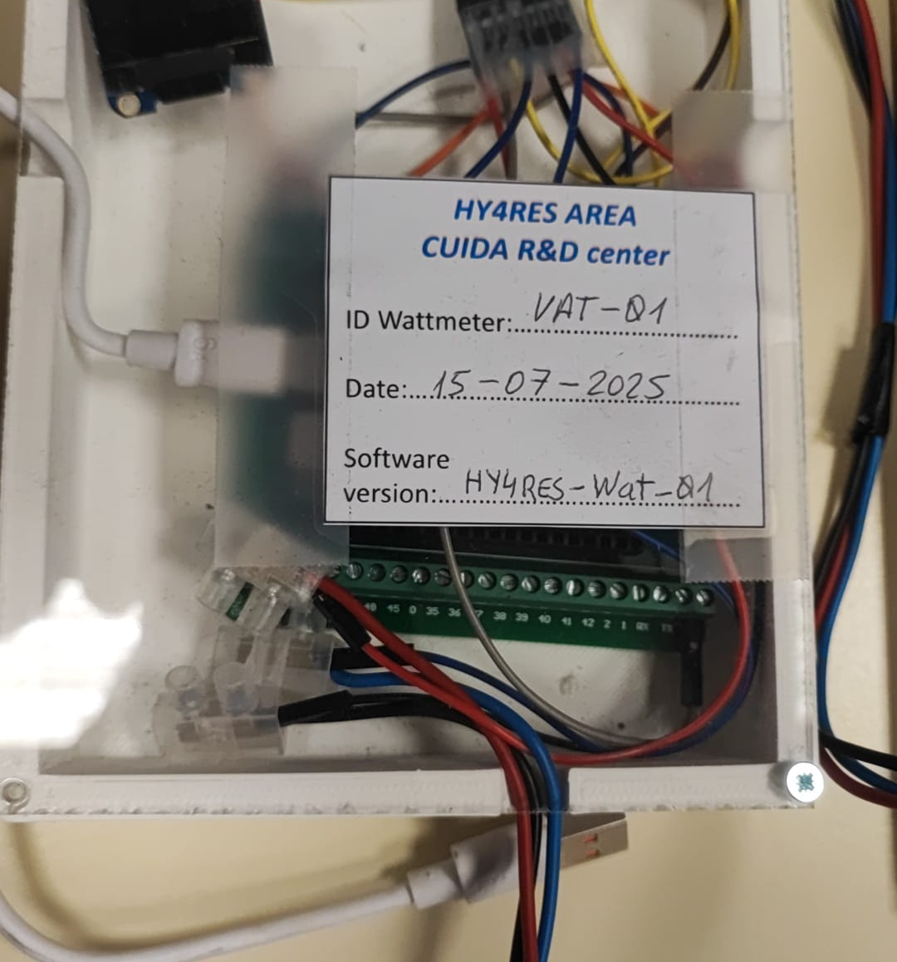
Small-scale renewables, large-scale impact
Energy transition also needs compact, flexible and low-cost solutions.
Other key needs:
Portability
Hybridization
Validation
Digitalization

Slide 5
HY4RES in one picture
Port of Avilés (Asturias, Spain)

Slide 6
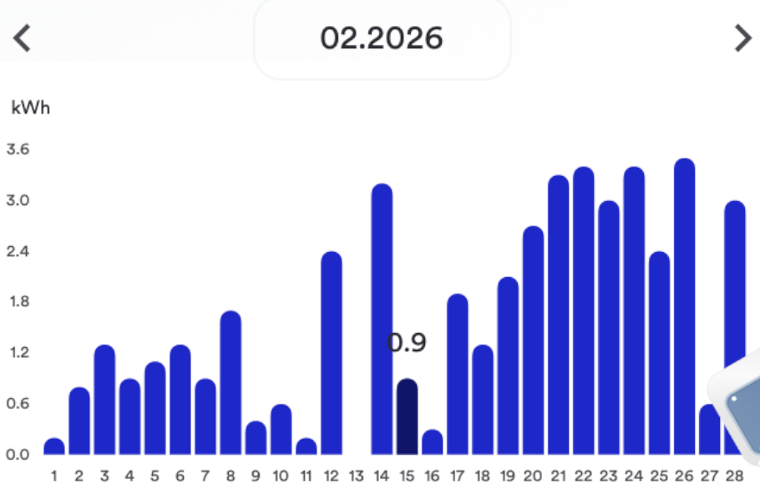
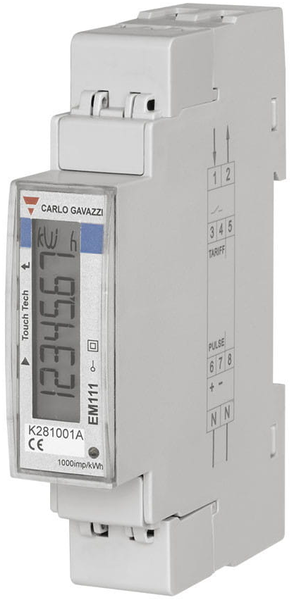

1st leg: solar system
3 solar panels [EX470-490TC (B)]
All-In-One Inverter + Battery
Parameter | Value
Total power | 1.20 kW
Generated energy per day | 1.944 kWh/day
Generated energy per year | 567.65 kWh/year
Standalone (storage)
Energy
IoT (Data)
Hybrid (mains+storage)

Slide 7
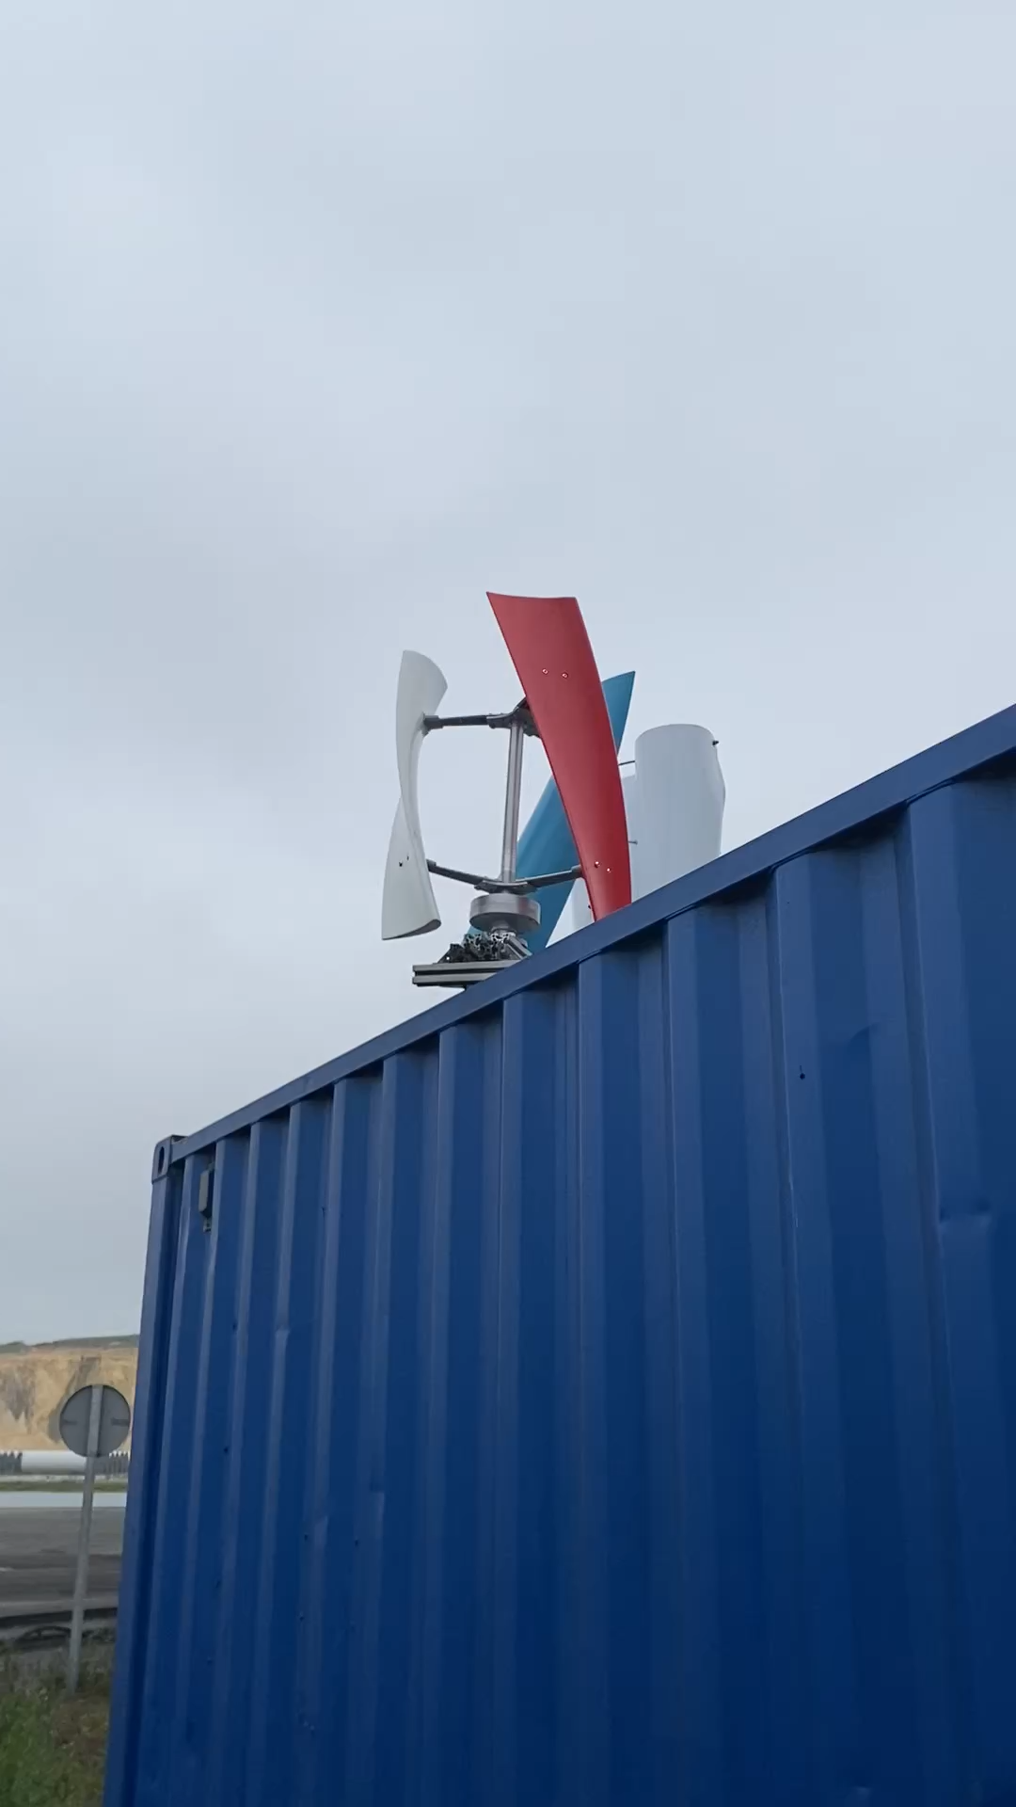
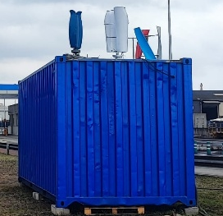
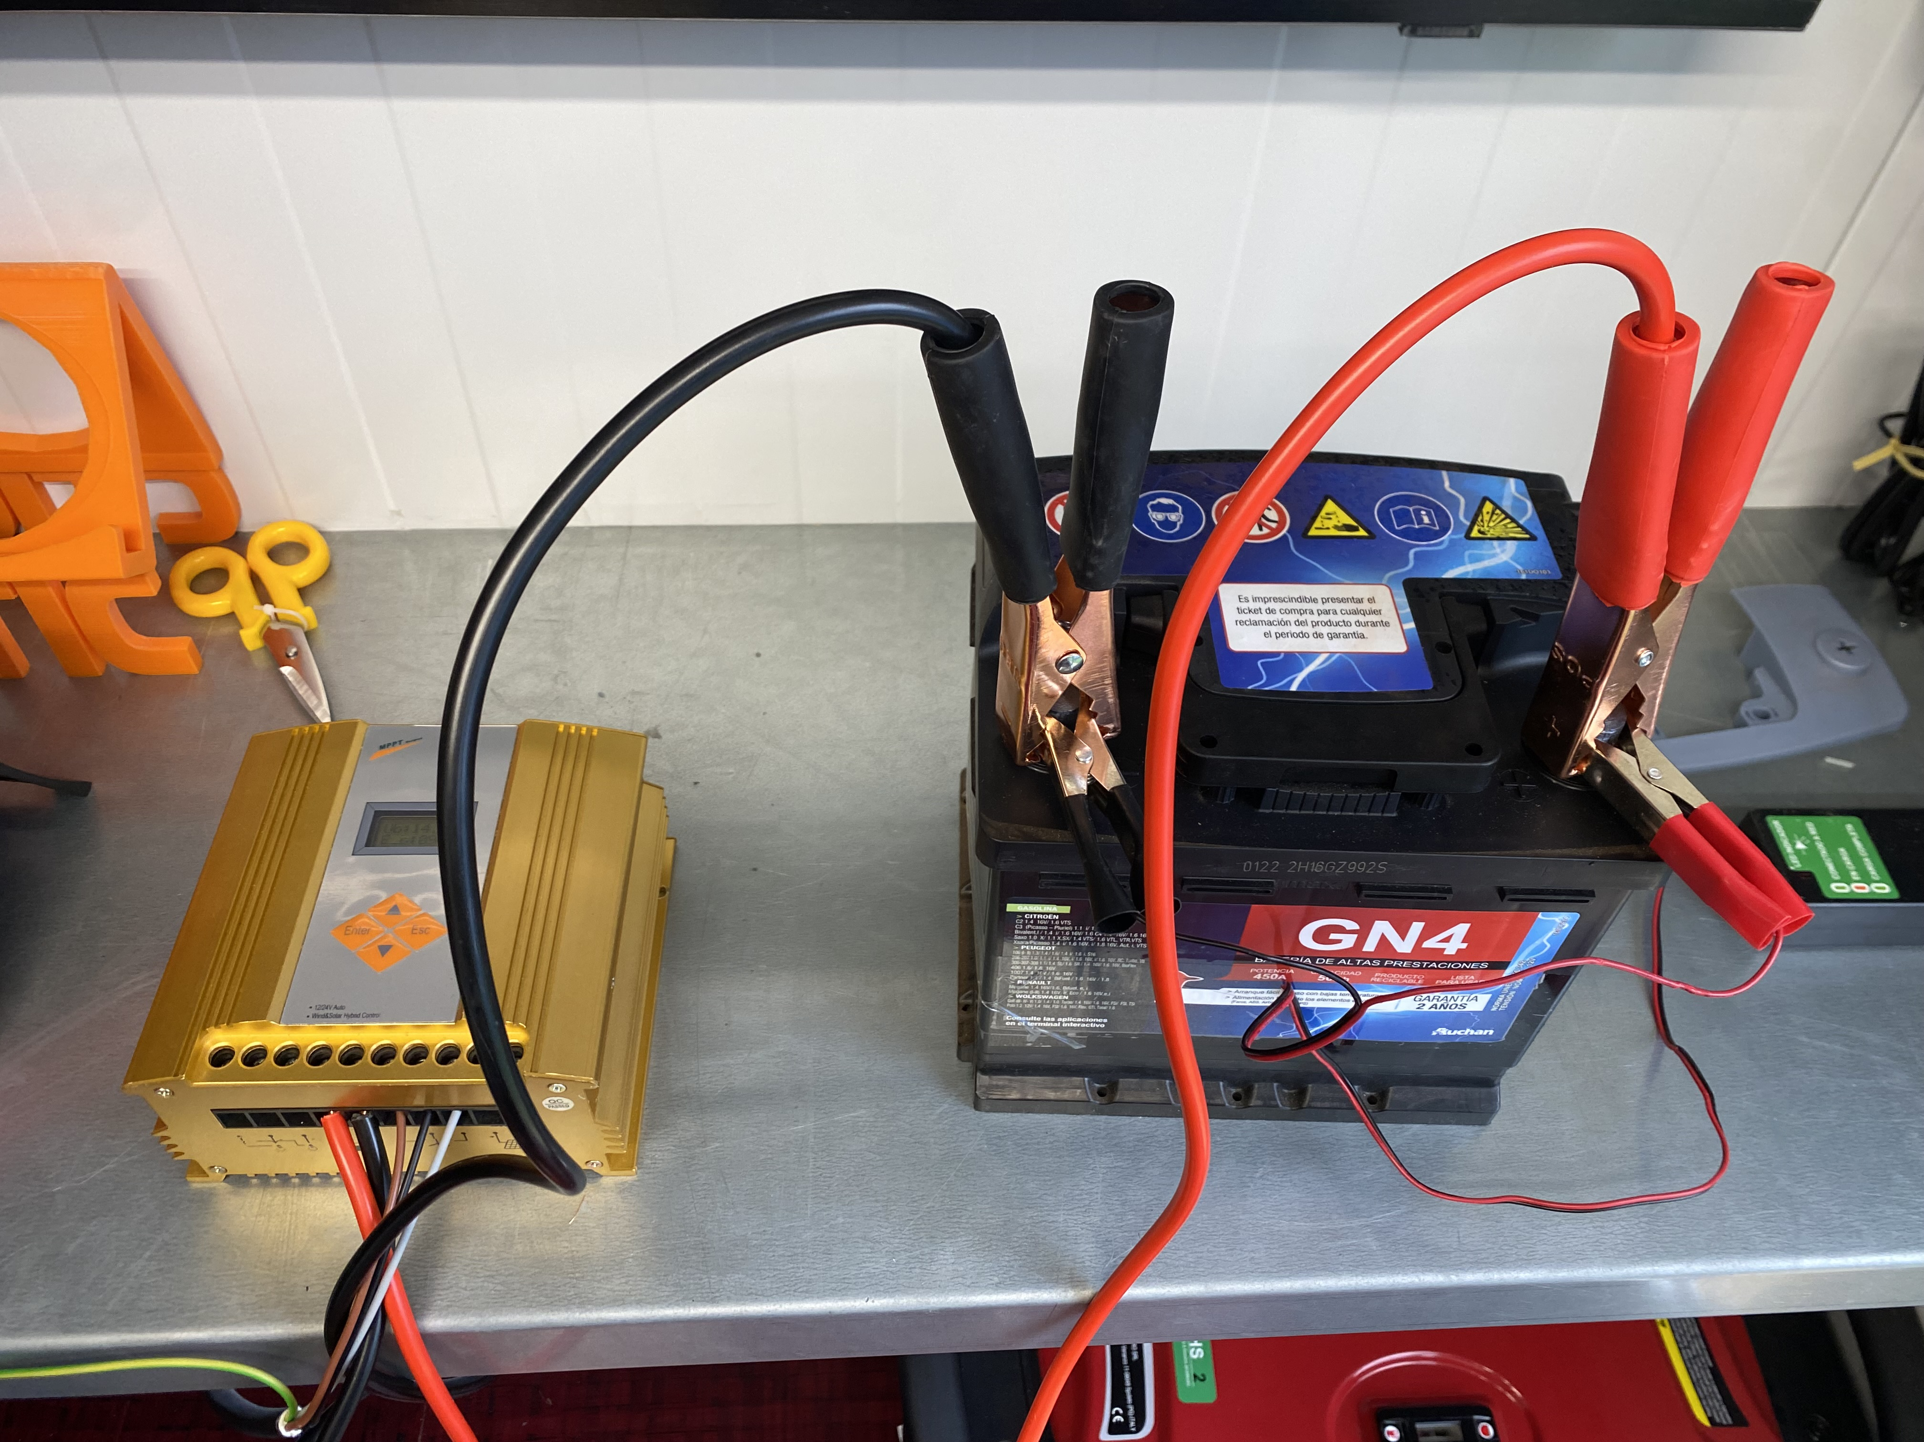
2nd leg: Wind turbines
3 vertical-axis wind turbines
  2 drag design (Savonius)
  1 lift design (Darrieus)
MPPT + battery
Parameter | Value
Total power | 675 W
Generated energy per day | 1.62 kWh/day
Generated energy per year | 473.04 kWh/year
Standalone (storage)
Electrical battery
Energy
IoT (Data)
Hybrid (mains+storage)
MPPT

Slide 8
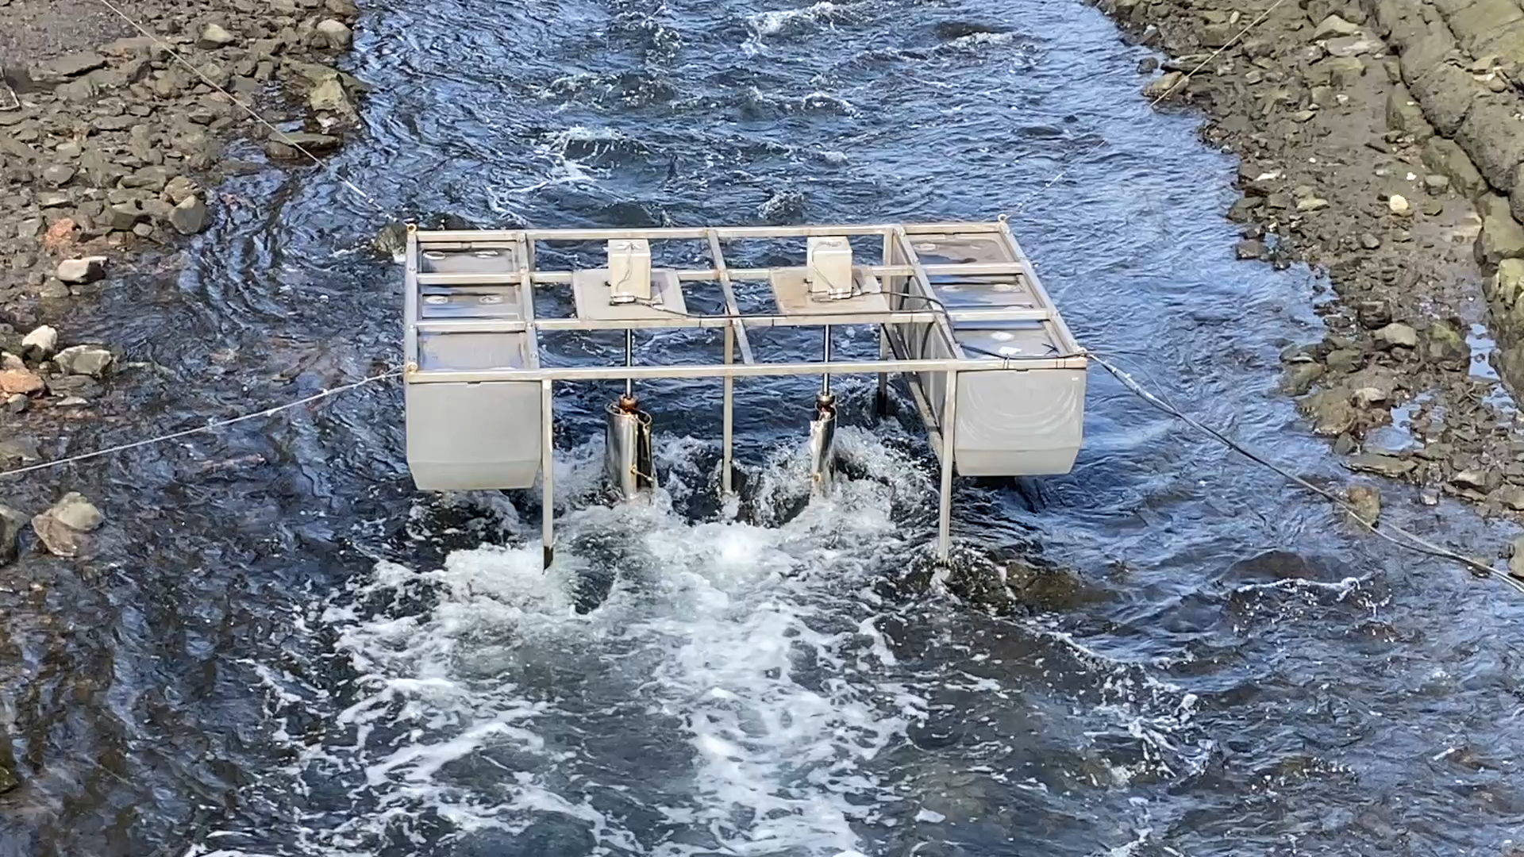
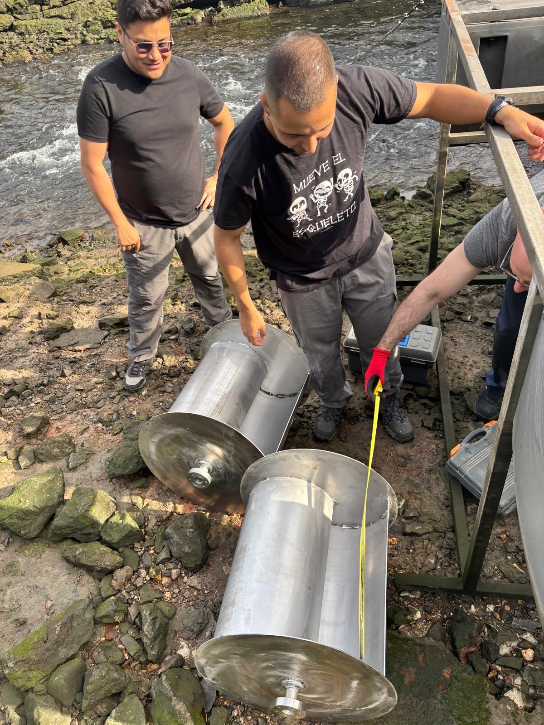
3rd leg: hydrokinetic turbines
Harness energy from an estuarine river.
2 vertical axis water turbines (VAWT).
  Drag type (Savonius)
  Floating platform with MPPT + batteries
Parameter | Value
Total power | 200 W
Generated energy per day | 240 Wh/day
Generated energy per year | 135.55 kWh/year
Standalone (storage)
Energy
IoT (Data)
Hybrid (mains+storage)

Slide 9
4th leg: storage PAT system
Pump-As-Turbine simulator
  Water tank.
  Pressure elevator device.
  Pipeline turbine.
Parameter | Value
Total power | 200 W
Generated energy per day | 480 Wh/day
Generated energy per year | 140.16 kWh/year
Standalone (storage)
Energy
IoT (Data)
Hybrid (mains+storage)

Slide 10
Balancing the renewable mix
Renewable sources:
  Solar PV.
  Wind turbines.
  Hydrokinetic turbines.
Renewable storage:
  P.A.T. hydro system.
Storage:
  Batteries.
Other sources:
  Power mains.
PAT
Water
Solar
Wind

Slide 11
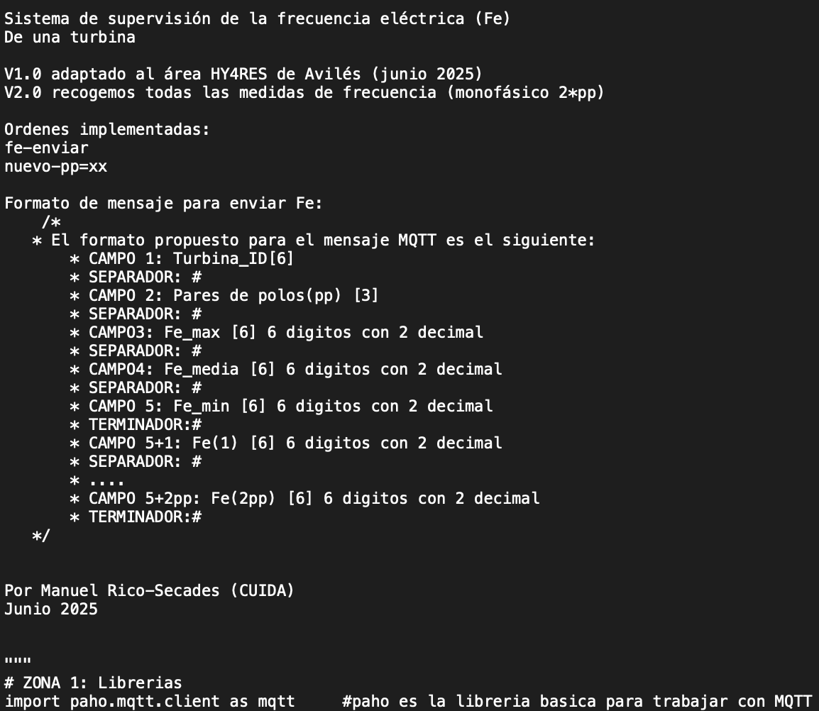
Internet of Energy: the brain of HY4RES
IoE layer enables HY4RES to become:
  Low-cost sensors:
    Voltage.
    Electric frequency.
  Controllable:
    Production.
    Storage.
    Consumption.
  Monitored:
    Predictable maintenance.
    Real-status.
    Hybridization
Python files

Slide 12
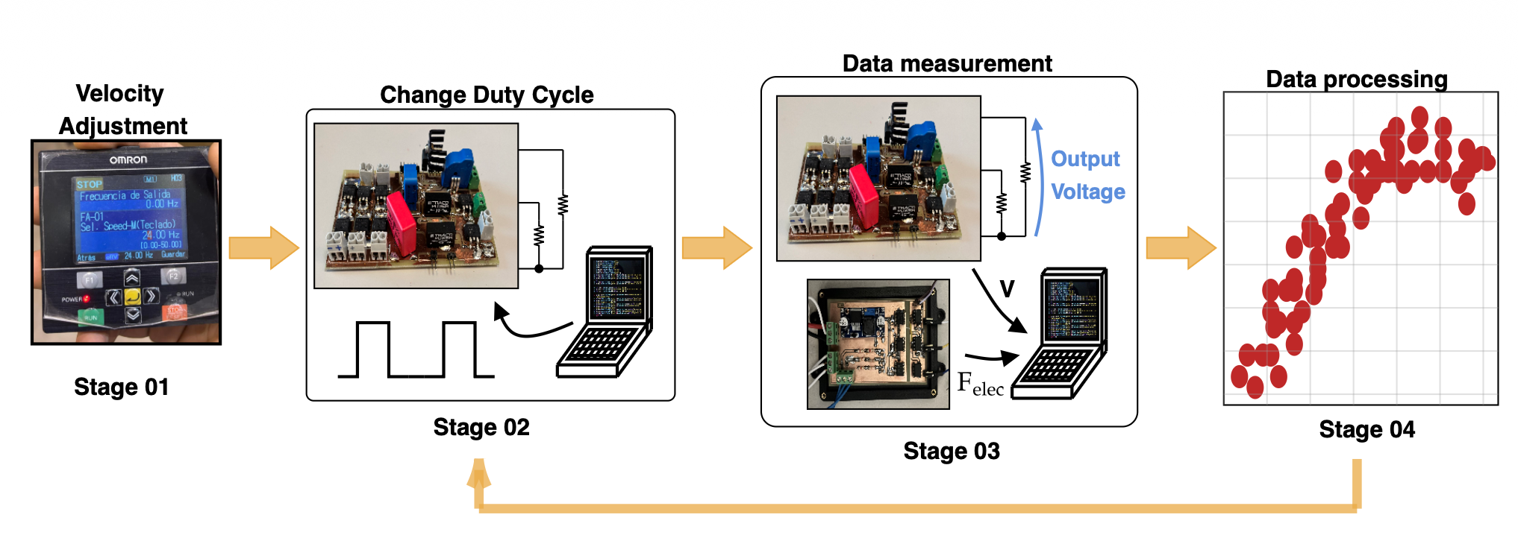
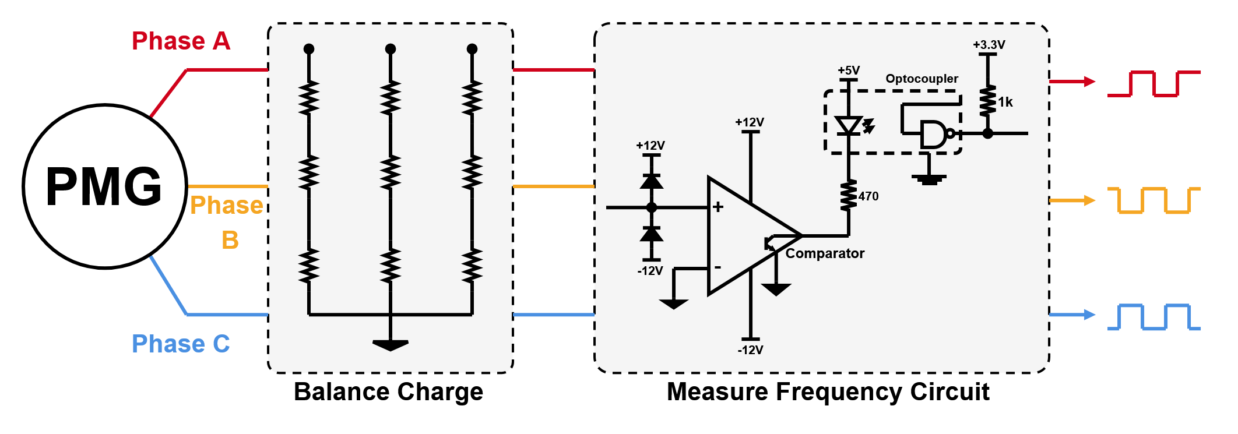
From data to decisions
IoE enables the acquisition of:
  Production
    PV through the status of All-In-One inverter.
    Wind, water turbines & PAT:
      Measuring voltage output.
  Consumption
    Controlling wattmeters.
  Status
    PV through variation of solar irradiance + production.
    Wind, water and PAT system → measuring electrical frequency.
MQTT protocol

Slide 13
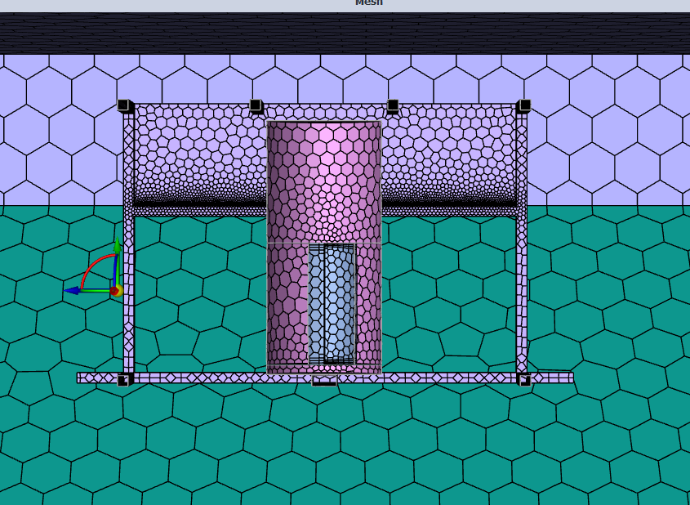
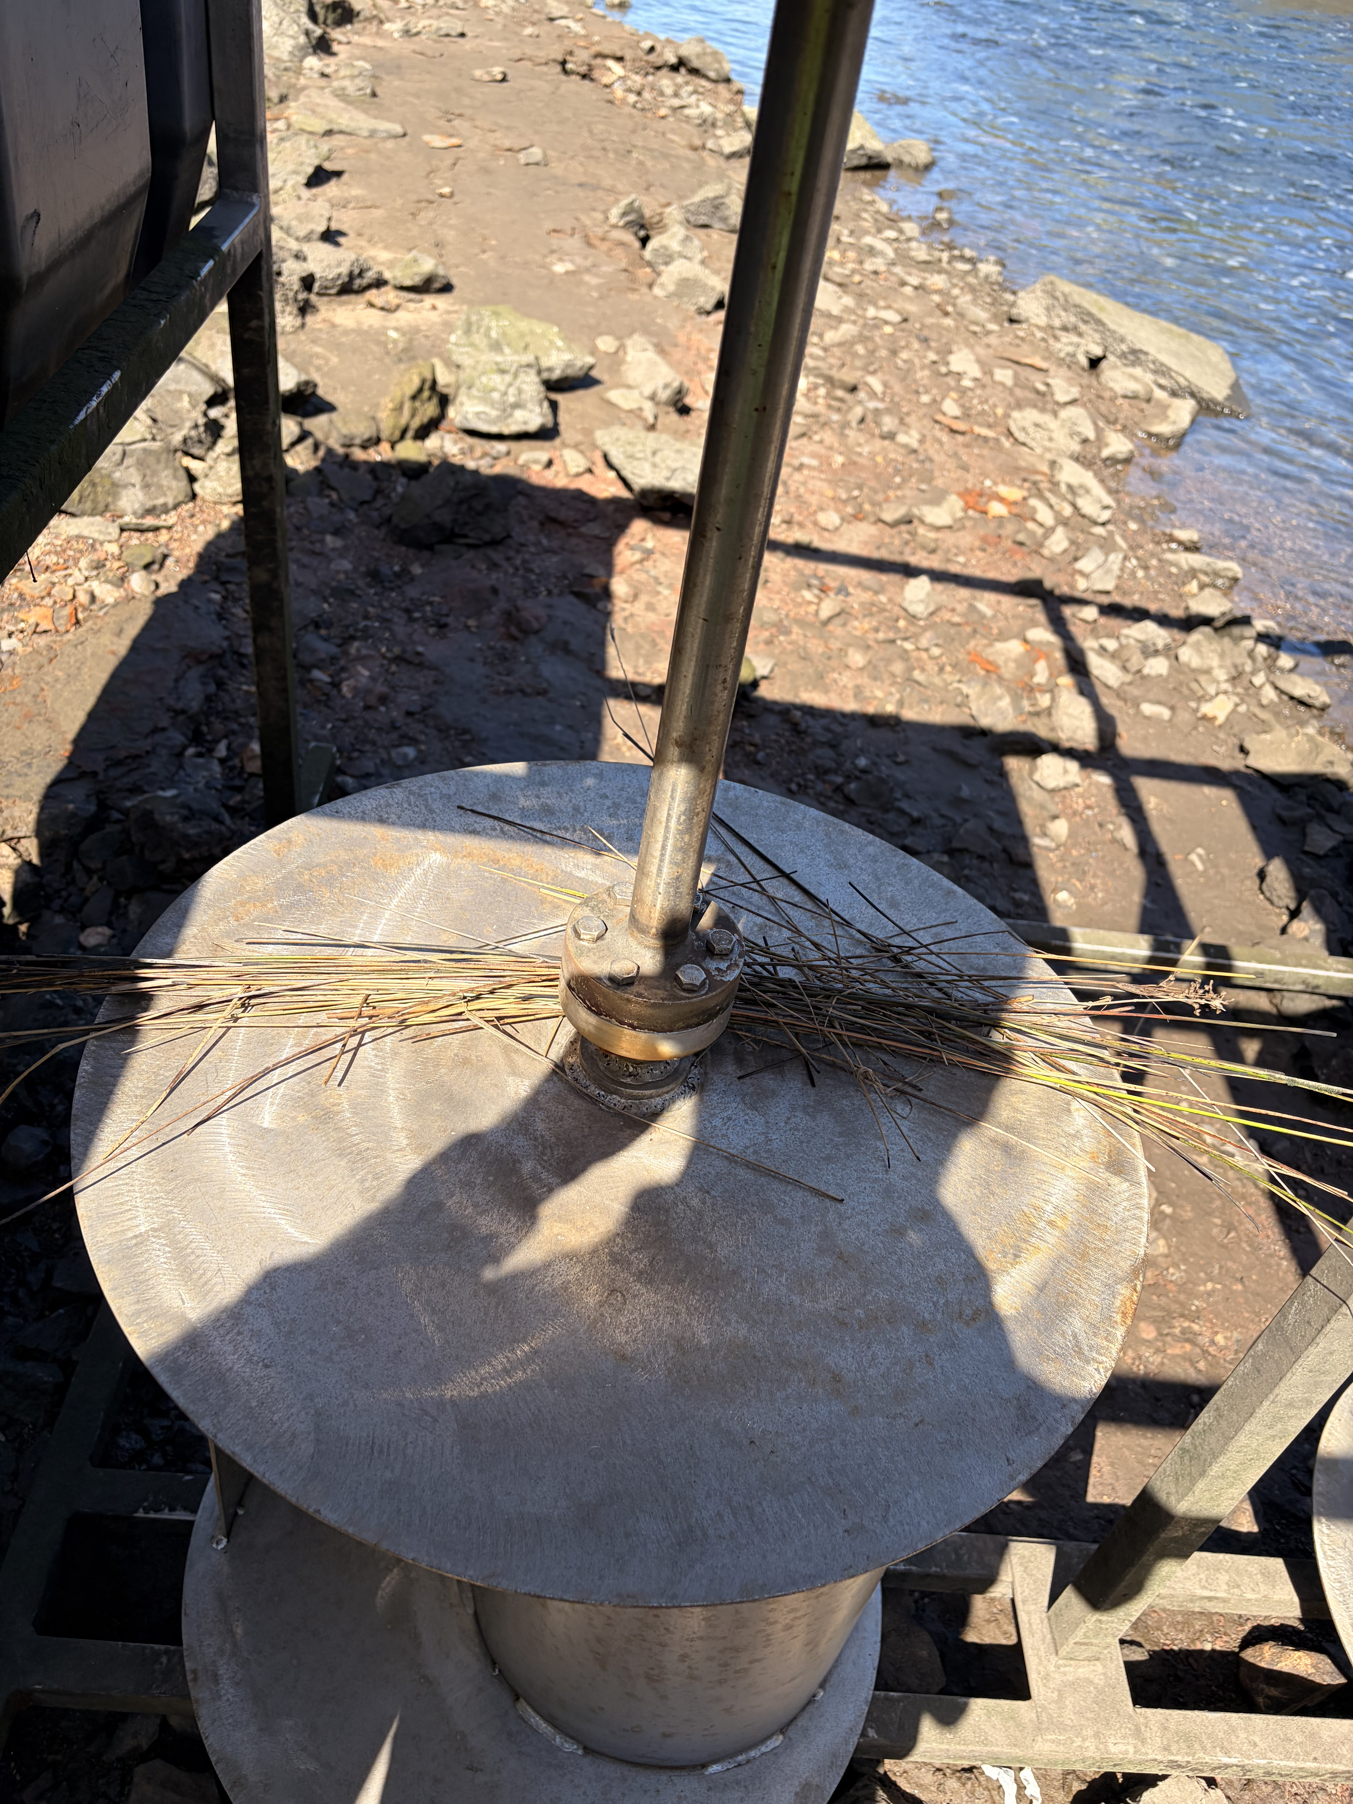
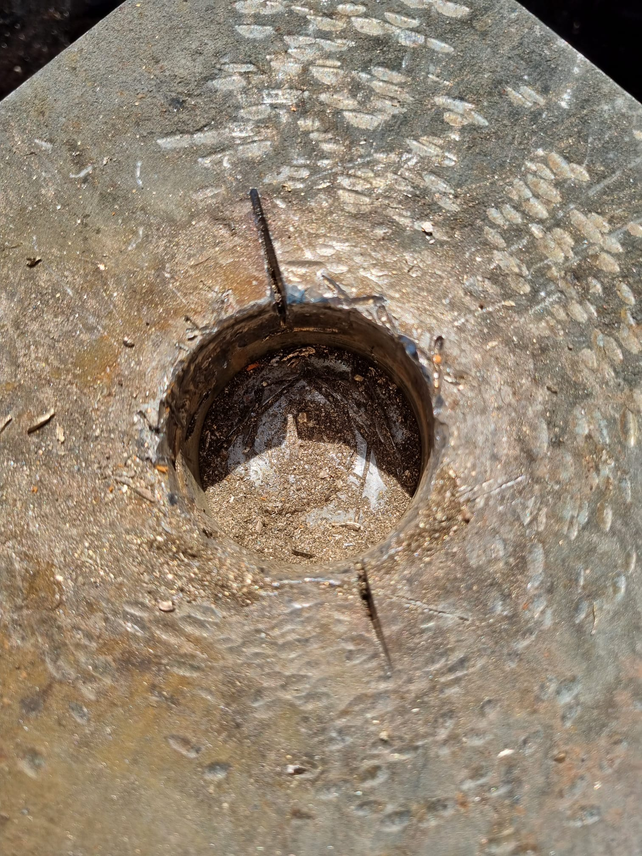
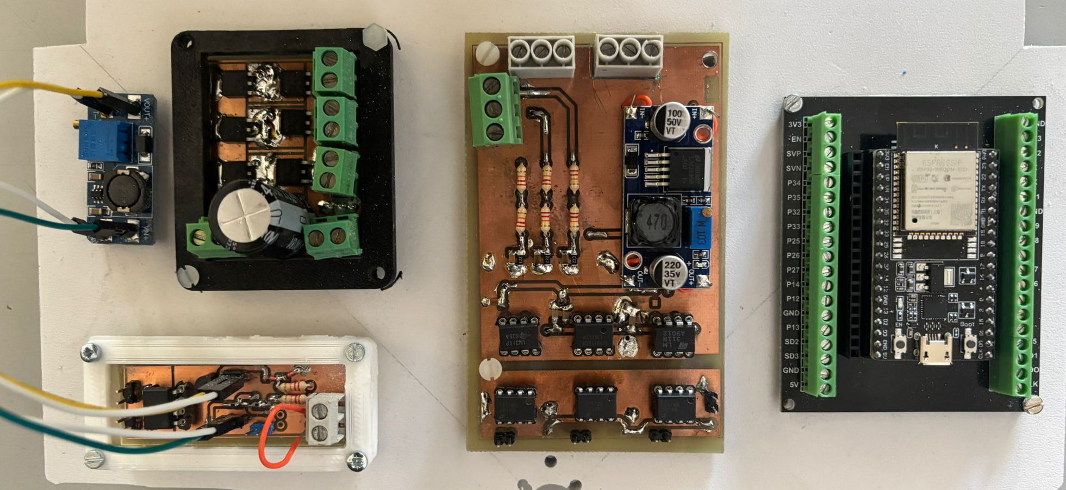
Main challenges
Futures steps should focus on:
  Hybrid integration
    Improve performance of turbines by new aerodynamic designs, PMG.
    CFD analysis.
  Port environment
    Dust and air pollution.
    Marine atmosphere → bearing
  Low-cost sensors
    Guarantee integration with IoE platform.
  Energy management
    New strategies to manage power mains-renewable generation-storage
  Predictive maintenance
    Develop AI algorithms to monitor renewable systems status.

Slide 14
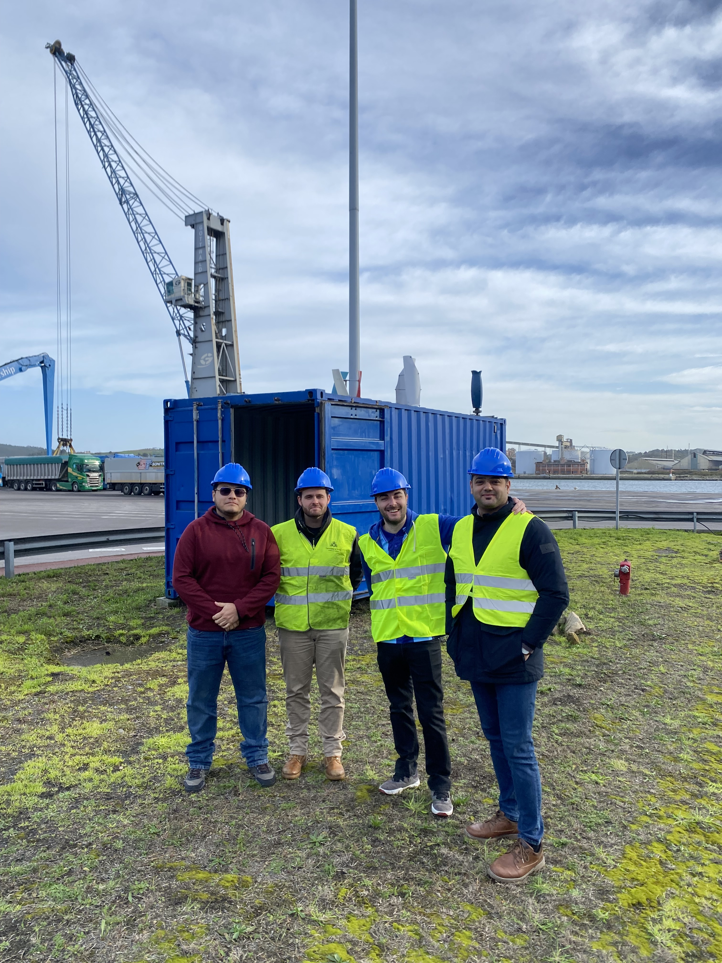
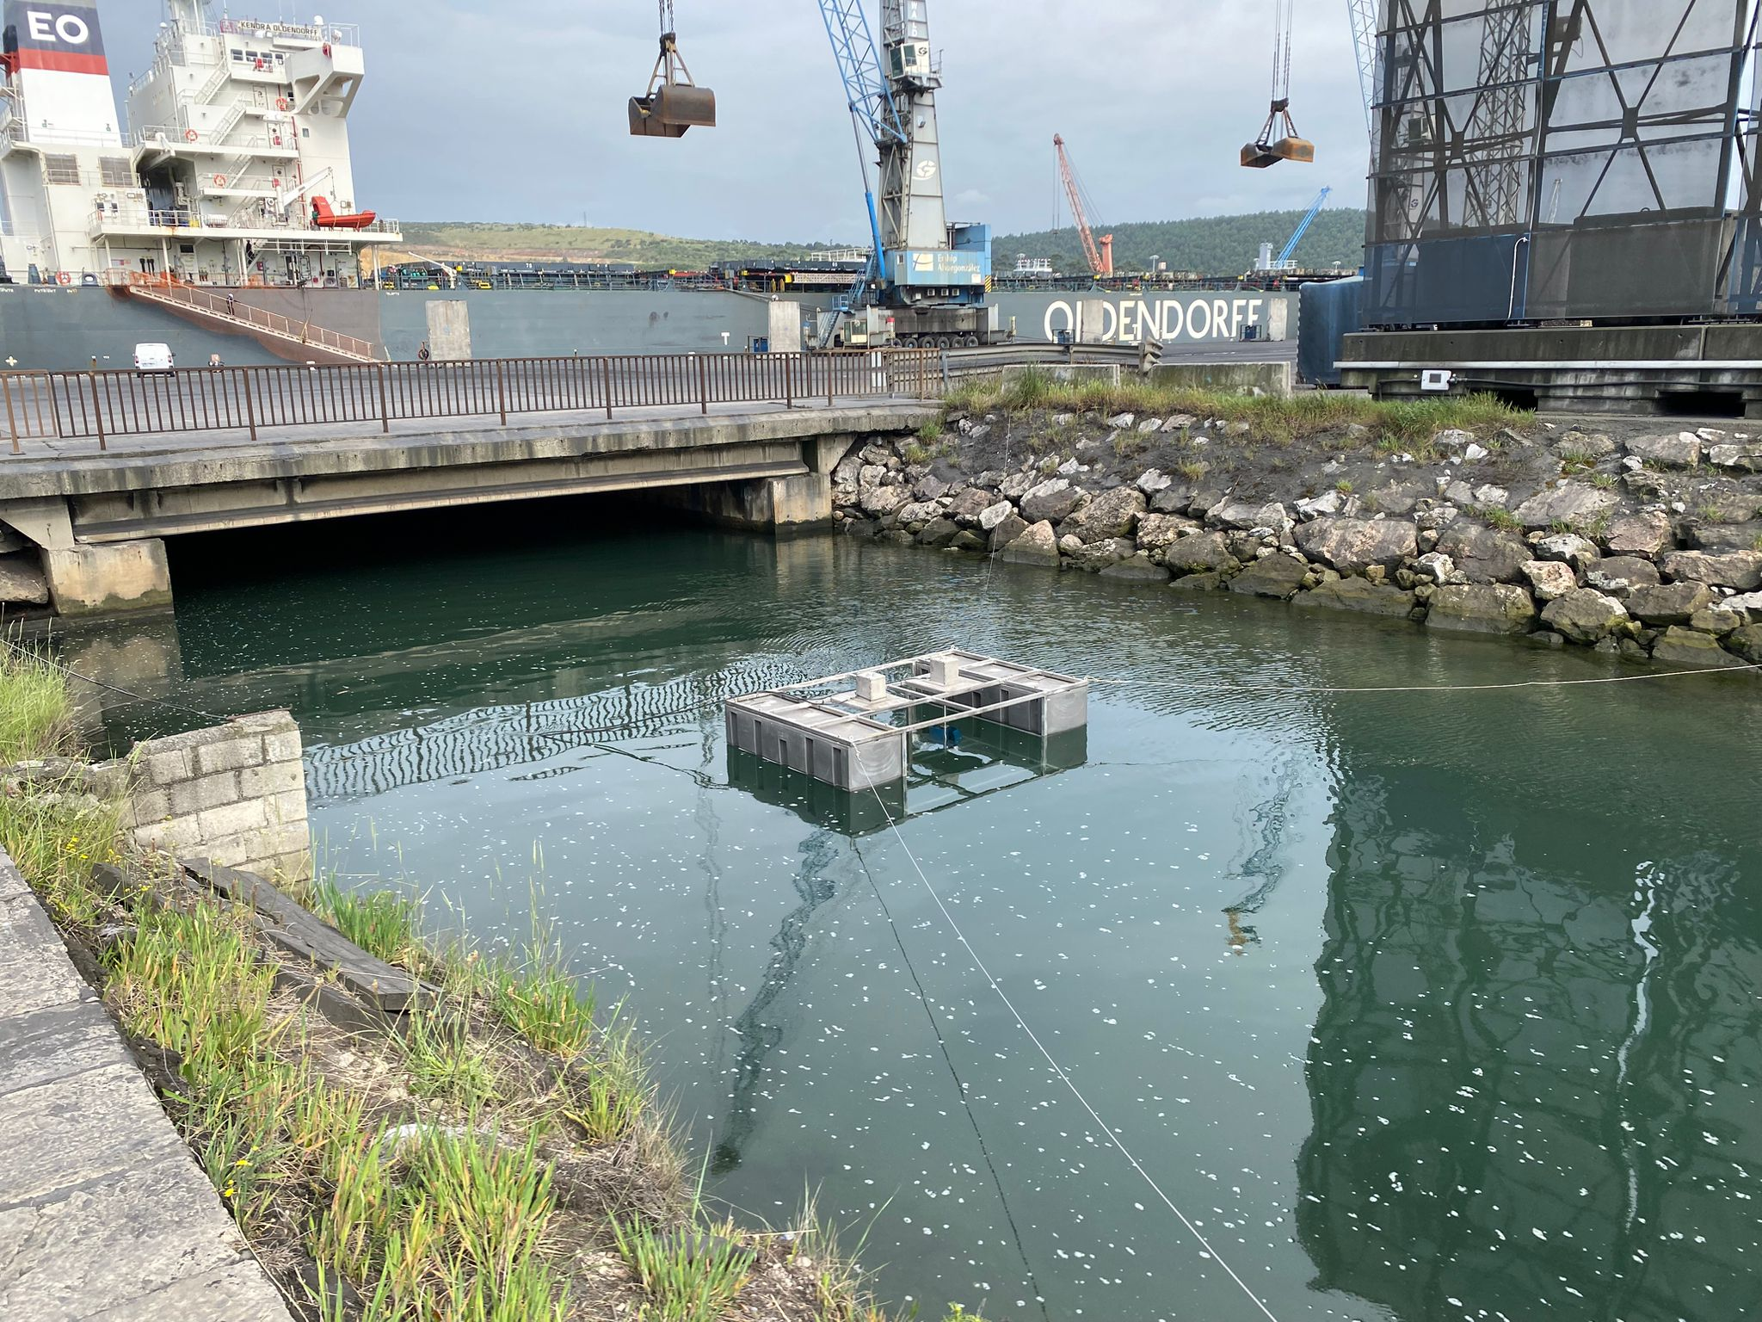
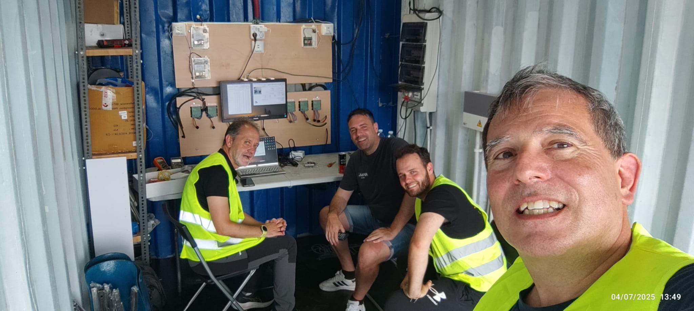
Achieved gaps
HY4RES reached these main gaps:
  Real deployment at the Port of Avilés.
  Low-cost → 25,000 $.
  Portability → A 20-ft containerized renewable platform.
  Hybridization → 4 complementary energy legs:
    Solar, wind, hydrokinetic and PAT.
  Dual storage concept → batteries + hydraulic storage.
  IoE/MQTT-based monitoring architecture.

Slide 15
Thank you very much for your attention!

